Slide 1
Topic: Number
QSpiders|JSpiders|PySpiders, NOIDA
B-4, Block-B, Sector-3, Noida
TOP 150 Programming Questions by Shambhu Sir
Monday, 11 August 2025
javac_java
kumarsam07
SHAMBHU KUMAR QSpiders |JSpiders | PySpiders, NOIDA
Q1
2651. Calculate Delayed Arrival Time
1
qspiders_jspiders_noida

Slide 2
Topic: Number
SHAMBHU KUMAR QSpiders |JSpiders | PySpiders, NOIDA
qspiders_jspiders_noida
WAP to swap two numbers using a third variable.
WAP to swap two numbers without using a third variable.
WAP to swap two numbers without using a third variable or without using + or – operator.
WAP to swap two numbers without using a third variable or without using +, –, * or / operator.
javac_java
kumarsam07
2

Slide 3
Topic: Number
SHAMBHU KUMAR QSpiders |JSpiders | PySpiders, NOIDA
qspiders_jspiders_noida
WAP to find max of two numbers without using any inbuilt function.
WAP to find max of three numbers without using any inbuilt function.
WAP to find second max of three numbers without using any inbuilt function.
javac_java
kumarsam07
3

Slide 4
Topic: Number
SHAMBHU KUMAR QSpiders |JSpiders | PySpiders, NOIDA
qspiders_jspiders_noida
Solve and answer value of c.
int a=12;
int b=20;
int c= a++ +b++ - ++a- --a;
System.out.println(c);
Solve and answer value of result.
int x = 5;
int result = x++ - --x + x-- - --x;
System.out.println(result);
javac_java
kumarsam07
4

Slide 5
Topic: Number
SHAMBHU KUMAR QSpiders |JSpiders | PySpiders, NOIDA
qspiders_jspiders_noida
Solve and answer value of x, y, z and p:
int x=12;
int y=x++ + ++x;
y++;
x--;
int z=++y;
int p=x++ - ++y + z++;
System.out.println(x);
System.out.println(y);
System.out.println(z);
System.out.println(p);
javac_java
kumarsam07
5

Slide 6
Topic: Number
SHAMBHU KUMAR QSpiders |JSpiders | PySpiders, NOIDA
qspiders_jspiders_noida
Solve and answer value of x.
int x=12;
x=x++;
x=x++;
x=x++;
x=++x;
x=x++;
System.out.println(x);
javac_java
kumarsam07
6

Slide 7
Topic: Number
SHAMBHU KUMAR QSpiders |JSpiders | PySpiders, NOIDA
qspiders_jspiders_noida
WAP to convert a number into absolute value.
WAP to take three inputs and print all are equal if all have same value or print biggest value of three numbers using if else statement.
WAP to check whether the given character is alphanumeric character or a special character.
WAP to check the given year is a Leap Year or NOT.
javac_java
kumarsam07
7

Slide 8
Topic: Number
SHAMBHU KUMAR QSpiders |JSpiders | PySpiders, NOIDA
qspiders_jspiders_noida
WAP to provide discounted price as per below conditions:
if shopping price>=10000 then %discount=40%
shopping price>=6000 and <=9999 then %discount=30%
shopping price>=3000 and <=5999 then %discount=20%
shopping price>=1 and <=2999 then %discount=8%
Type of Triangle
javac_java
kumarsam07
8

Slide 9
Topic: Number
SHAMBHU KUMAR QSpiders |JSpiders | PySpiders, NOIDA
qspiders_jspiders_noida
WAP to count the digits in a number.
WAP to get the sum of each digits of the number.
Harshad Number
Subtract the Product and Sum of Digits of an Integer
Check Divisibility by Digit Sum and Product
Maximum Product of Two Digits
Add Digits
javac_java
kumarsam07
9

Slide 10
Topic: Number
SHAMBHU KUMAR QSpiders |JSpiders | PySpiders, NOIDA
qspiders_jspiders_noida
WAP to reverse the given number.
Mirror Distance of an Integer
Palindrome Number
A Number After a Double Reversal
javac_java
kumarsam07
10

Slide 11
Topic: Number
SHAMBHU KUMAR QSpiders |JSpiders | PySpiders, NOIDA
qspiders_jspiders_noida
Power of Two
Power of Three
Power of Four
Number of 1 Bits:
javac_java
kumarsam07
11

Slide 12
Topic: Number
SHAMBHU KUMAR QSpiders |JSpiders | PySpiders, NOIDA
qspiders_jspiders_noida
Factorial Trailing Zeroes
Number of Steps to Reduce a Number to Zero
Remove Zeros in Decimal Representation
Concatenate Non-Zero Digits and Multiply by Sum I
javac_java
kumarsam07
12

Slide 13
Topic: Number
SHAMBHU KUMAR QSpiders |JSpiders | PySpiders, NOIDA
qspiders_jspiders_noida
Water Bottles
Wrapper Exchange Problem:
Problem Statement: Rohan has X rupees. He wants to buy chocolates from a shop. Each chocolate costs Y rupees. Every chocolate comes with one wrapper. The shopkeeper has a special offer: Exchange Z wrappers for 1 free chocolate. Every free chocolate also gives one wrapper, which can be used in future exchanges. Find the maximum number of chocolates Rohan can eat.
i/p: money = 15 cost = 1 wrappersNeeded = 3
o/p: 22
javac_java
kumarsam07
13

Slide 14
Topic: Number
SHAMBHU KUMAR QSpiders |JSpiders | PySpiders, NOIDA
qspiders_jspiders_noida
WAP to print and count all factors of a number.
Write an optimized program to check whether the given number is a prime number or NOT.
Print and count all prime numbers in a range.
Print nth prime number.
Store first 100 prime numbers in a list/array.
javac_java
kumarsam07
14

Slide 15
Topic: Number
SHAMBHU KUMAR QSpiders |JSpiders | PySpiders, NOIDA
qspiders_jspiders_noida
WAP to generate n terms of Fibonacci series.
Fibonacci Number
WAP to generate all n terms of Tribonacci series.
javac_java
kumarsam07
15

Slide 16
Topic: Number
SHAMBHU KUMAR QSpiders |JSpiders | PySpiders, NOIDA
qspiders_jspiders_noida
WAP to check whether the given number is an Armstrong number or NOT.
Print and count all Armstrong numbers in a range.
WAP to take user input and print whether the number is dissarium number or not.
WAP to print and count all the dissarium numbers in a range.
javac_java
kumarsam07
16

Slide 17
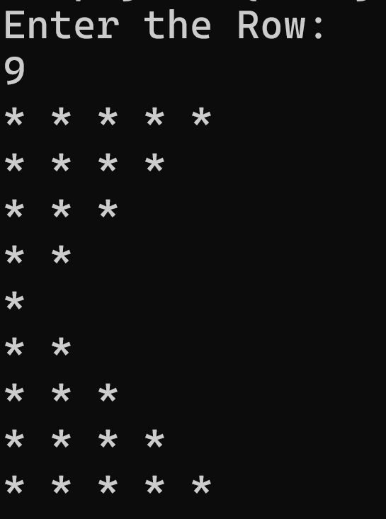
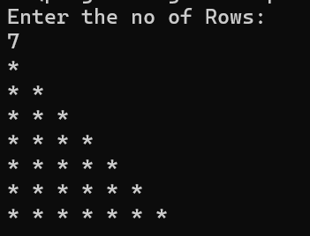
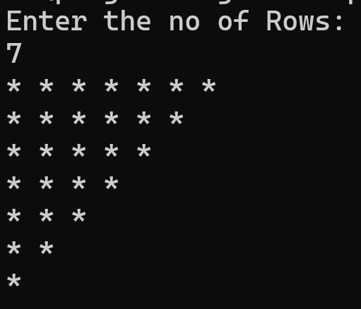
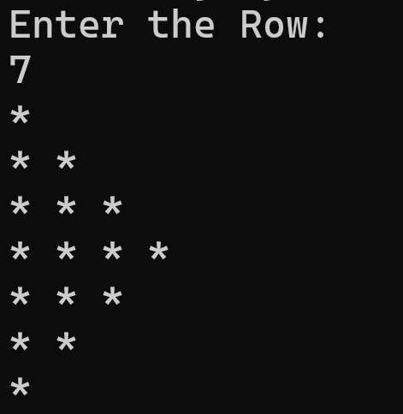
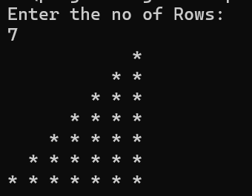
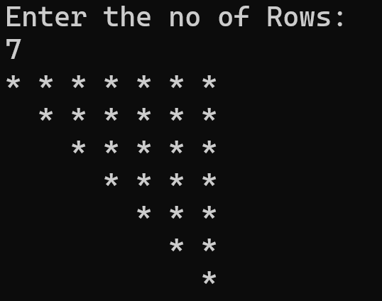
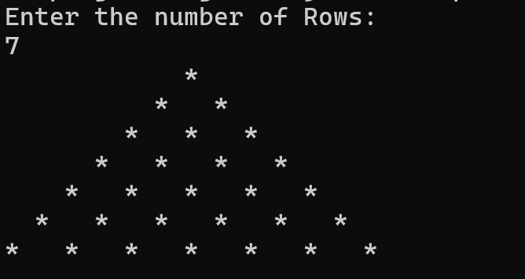
Topic: Pattern
SHAMBHU KUMAR QSpiders |JSpiders | PySpiders, NOIDA
qspiders_jspiders_noida
Print Pattern:
javac_java
kumarsam07
17

Slide 18
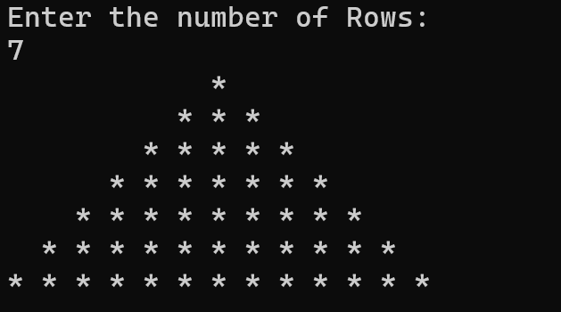
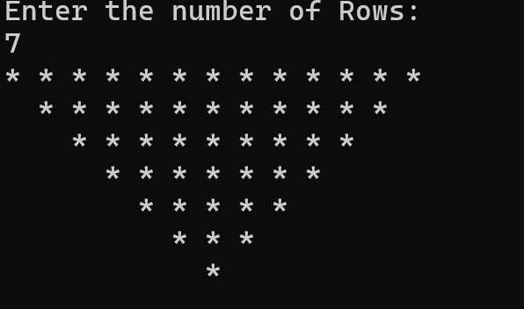
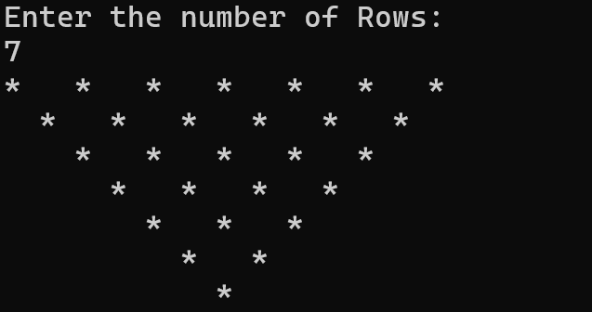
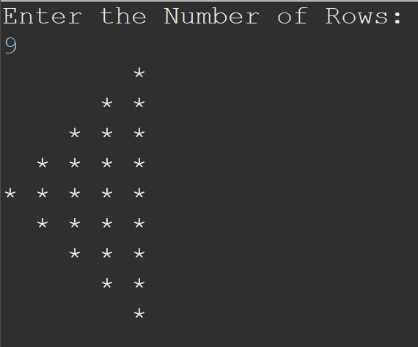
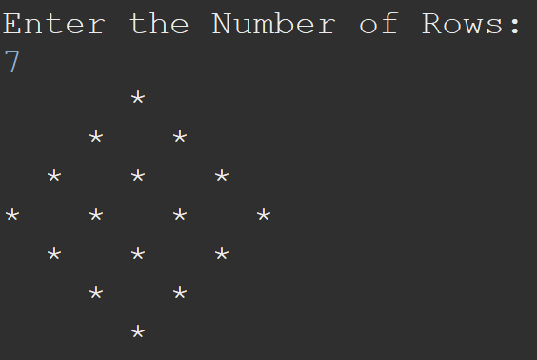
Topic: Pattern
SHAMBHU KUMAR QSpiders |JSpiders | PySpiders, NOIDA
qspiders_jspiders_noida
Print Pattern:
javac_java
kumarsam07
18

Slide 19
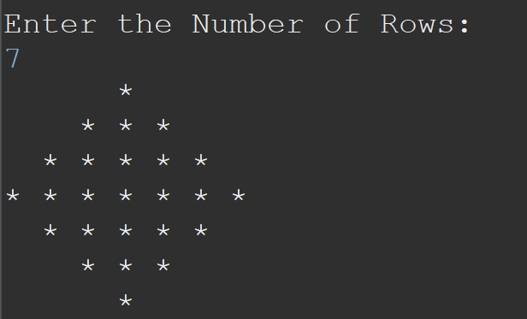
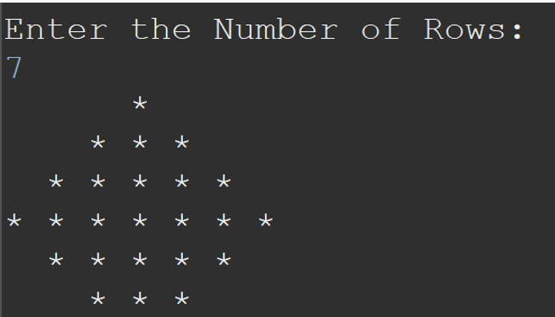
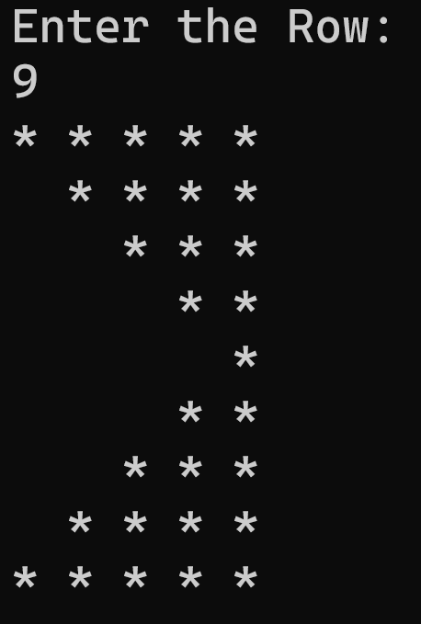
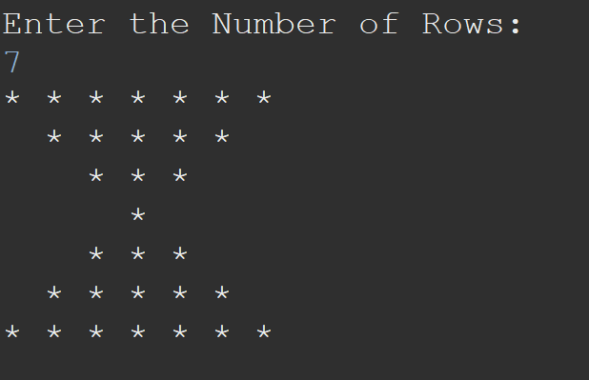
Topic: Pattern
SHAMBHU KUMAR QSpiders |JSpiders | PySpiders, NOIDA
qspiders_jspiders_noida
Print Pattern:
javac_java
kumarsam07
19

Slide 20
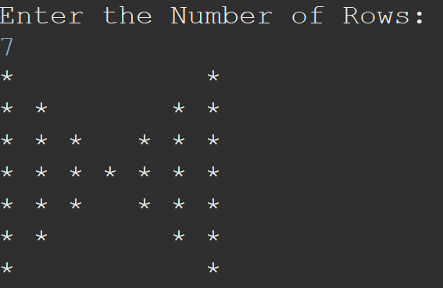
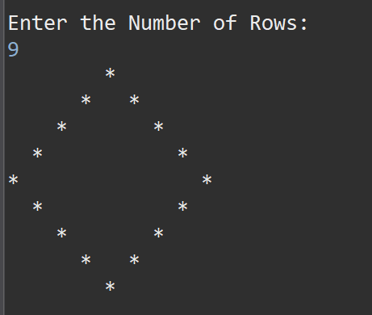
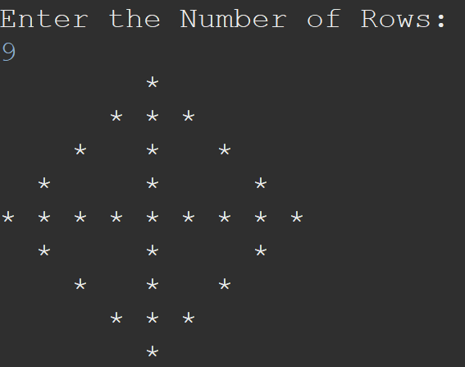
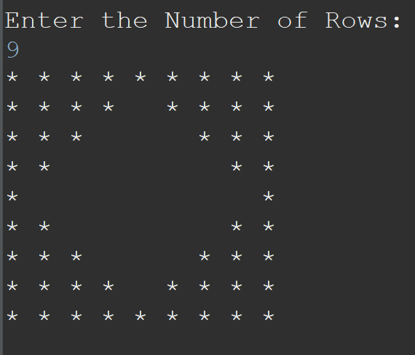
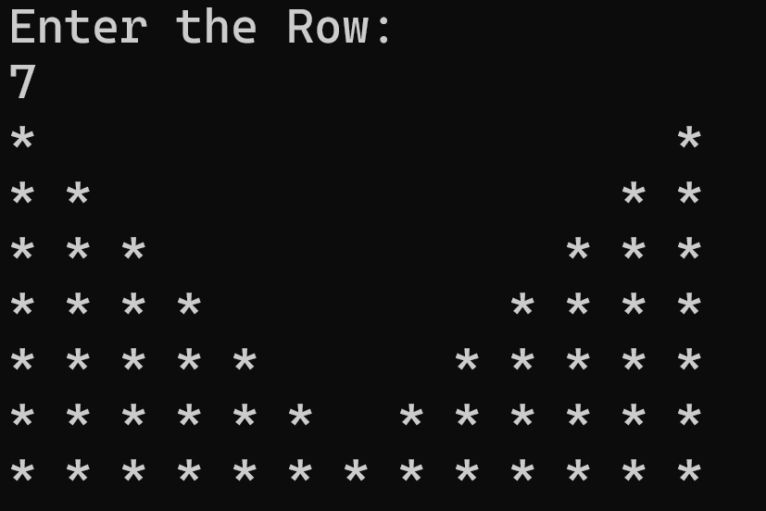
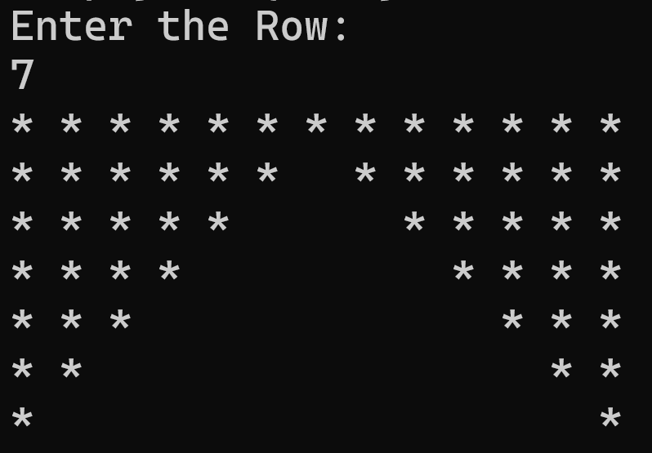
Topic: Pattern
SHAMBHU KUMAR QSpiders |JSpiders | PySpiders, NOIDA
qspiders_jspiders_noida
Print Pattern:
javac_java
kumarsam07
20

Slide 21
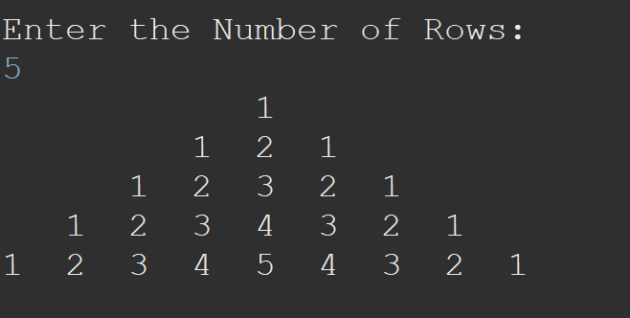
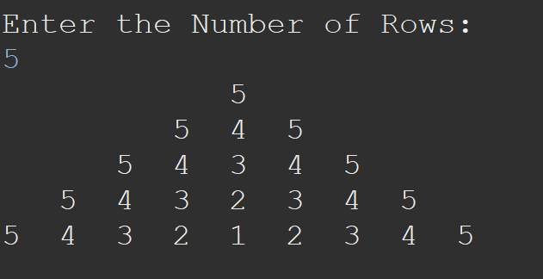
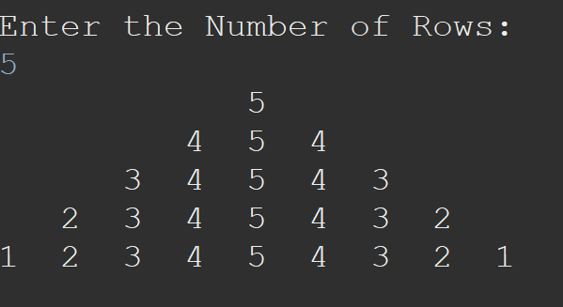
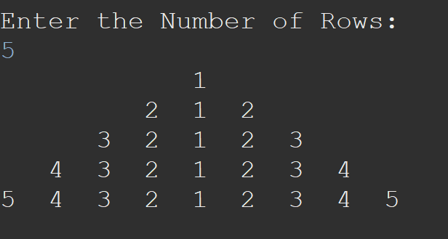
Topic: Pattern
SHAMBHU KUMAR QSpiders |JSpiders | PySpiders, NOIDA
qspiders_jspiders_noida
Print Pattern:
javac_java
kumarsam07
21

Slide 22
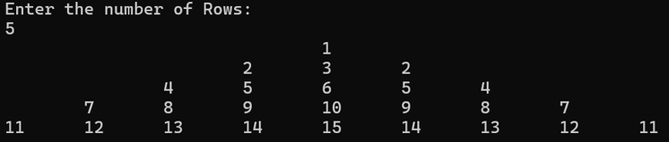
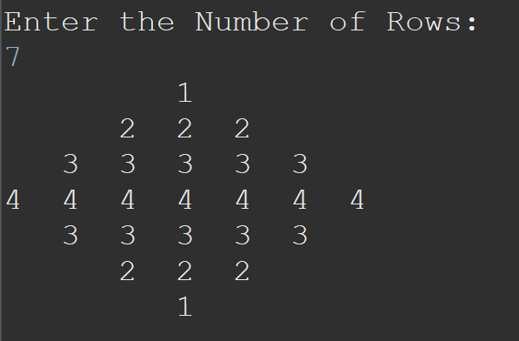
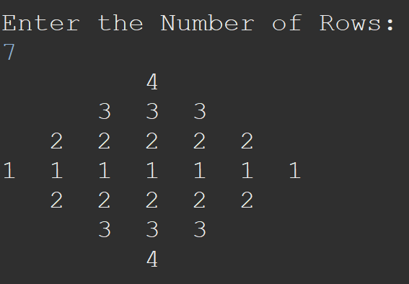
Topic: Pattern
SHAMBHU KUMAR QSpiders |JSpiders | PySpiders, NOIDA
qspiders_jspiders_noida
Print Pattern:
javac_java
kumarsam07
22

Slide 23
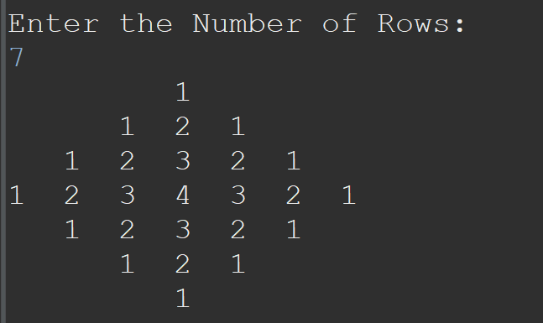
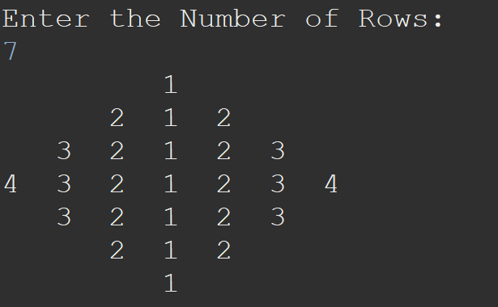
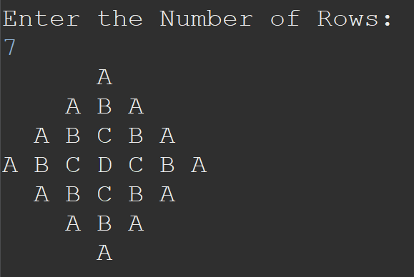
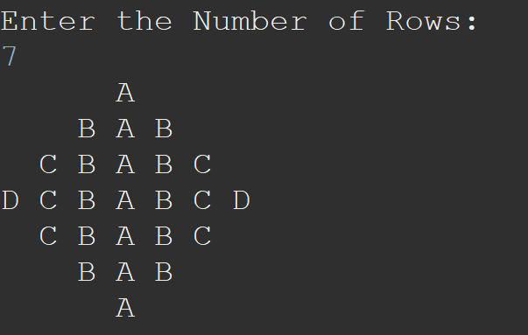
Topic: Pattern
SHAMBHU KUMAR QSpiders |JSpiders | PySpiders, NOIDA
qspiders_jspiders_noida
Print Pattern:
javac_java
kumarsam07
23

Slide 24
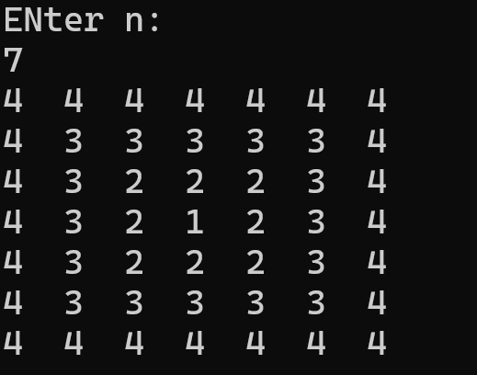
Topic: Pattern
SHAMBHU KUMAR QSpiders |JSpiders | PySpiders, NOIDA
qspiders_jspiders_noida
1. Print Pattern:
2. Print the below Series:
2 6 12 20 30 42
2 5 11 23 47 95 191 383 767 1535
3 5 9 17 33
1 2 5 26 677
0 1 1 2 3 5 8 13 21 [Fibonacci Series]
0 1 1 2 4 7 13 24 [Tribonacci Series]
javac_java
kumarsam07
24

Slide 25
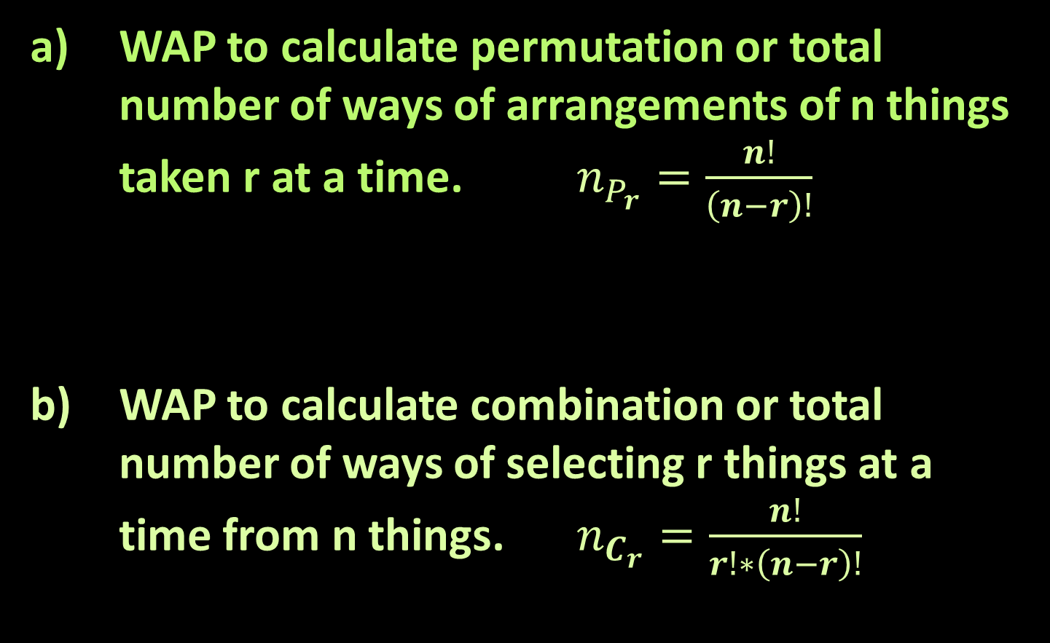
Topic: Number
SHAMBHU KUMAR QSpiders |JSpiders | PySpiders, NOIDA
qspiders_jspiders_noida
WAP to calculate permutation or total number of ways of arrangements of n things taken r at a time. $n_{P_{r}}=\frac{n!}{\left(n−r\right)!}$
WAP to calculate combination or total number of ways of selecting r things at a time from n things. $n_{C_{r}}=\frac{n!}{r!∗\left(n−r\right)!}$
javac_java
kumarsam07
25

Slide 26
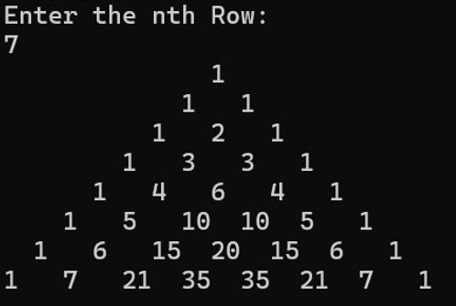
Topic: Number
SHAMBHU KUMAR QSpiders |JSpiders | PySpiders, NOIDA
qspiders_jspiders_noida
119. Pascal's Triangle II
118. Pascal's Triangle
Generate Pascal’s Triangle:
javac_java
kumarsam07
26

Slide 27


Topic: Array
SHAMBHU KUMAR QSpiders |JSpiders | PySpiders, NOIDA
qspiders_jspiders_noida
WAP to swap two index values of the array. Swap index 1 and 5 elements:
Original array:
Swapped array:
to print max and min element of array.
For the given array of Strings, print the largest string.
javac_java
kumarsam07
27

Slide 28
Topic: Array
SHAMBHU KUMAR QSpiders |JSpiders | PySpiders, NOIDA
qspiders_jspiders_noida
WAP to get sum of all elements of array.
WAP to get average of all elements of array.
WAP to get average of all elements at even index of array.
Difference Between Element Sum and Digit Sum of an Array
javac_java
kumarsam07
28

Slide 29
Topic: Array
SHAMBHU KUMAR QSpiders |JSpiders | PySpiders, NOIDA
qspiders_jspiders_noida
WAP to print and count all prime number elements of array.
Maximum Prime Difference
WAJP to print and count all palindrome number elements of array.
javac_java
kumarsam07
29

Slide 30
Topic: Array
SHAMBHU KUMAR QSpiders |JSpiders | PySpiders, NOIDA
qspiders_jspiders_noida
Monotonic Array
You are given an integer array coins representing coins of different denominations and an integer amount representing a total amount of money. Write a function to compute the fewest number of coins that you need to make up that amount. You must return the count of each specific denomination used.
i/p: coins = [100, 50, 10, 5, 2, 1], amount = 371
o/p: [3, 1, 2, 0, 0, 1]
javac_java
kumarsam07
30

Slide 31
Topic: Array
SHAMBHU KUMAR QSpiders |JSpiders | PySpiders, NOIDA
qspiders_jspiders_noida
Two Sum
javac_java
kumarsam07
31

Slide 32
Topic: Array
SHAMBHU KUMAR QSpiders |JSpiders | PySpiders, NOIDA
qspiders_jspiders_noida
Max Consecutive Ones
javac_java
kumarsam07
32

Slide 33
Topic: Array
SHAMBHU KUMAR QSpiders |JSpiders | PySpiders, NOIDA
qspiders_jspiders_noida
WAP to find Second distinct biggest element of the array.
int[] a= {80, 80, 43, 50, 38, 63, 58, 80};
o/p
63
Largest and Second Largest Practice Problem in Arrays
c) Maximum Product of Two Elements in an Array
javac_java
kumarsam07
33

Slide 34
Topic: Array
SHAMBHU KUMAR QSpiders |JSpiders | PySpiders, NOIDA
qspiders_jspiders_noida
WAP to print Second Smallest element of the array.
int[] a= {80, 80, 43, 50, 38, 63, 38, 80};
o/p
38
b) WAP to print Second distinct Smallest element of the array.
int[] a= {80, 80, 43, 50, 38, 63, 38, 80};
o/p
43
javac_java
kumarsam07
34

Slide 35
Topic: Array
SHAMBHU KUMAR QSpiders |JSpiders | PySpiders, NOIDA
qspiders_jspiders_noida
Third Maximum Number
javac_java
kumarsam07
35

Slide 36
Topic: Array
SHAMBHU KUMAR QSpiders |JSpiders | PySpiders, NOIDA
qspiders_jspiders_noida
a) Sunlight Problem:
In left side we have sun and array contains height of buildings. How many buildings will get sun light?
i/p:[4, 2, 6, 8, 5, 7, 12, 6]
o/p: 4
b) Sunlight Problem:
In left side we have sun and array contains height of buildings. Get index of all buildings which will get sun light?
i/p:[4, 2, 6, 8, 5, 7, 12, 6]
o/p: [0, 2, 3, 6]
javac_java
kumarsam07
36

Slide 37
Topic: Array
SHAMBHU KUMAR QSpiders |JSpiders | PySpiders, NOIDA
qspiders_jspiders_noida
a) Oceanview Problem:
In right side we have Ocean and array contains height of buildings. How many buildings will get Ocean view?
i/p:[4, 2, 6, 18, 5, 7, 12, 6]
o/p: 3
b) Oceanview Problem:
In right side we have Ocean and array contains height of buildings. Get all the index of buildings which will get Ocean view?
i/p:[4, 2, 6, 18, 5, 7, 12, 6]
o/p: [3,6,7]
javac_java
kumarsam07
37

Slide 38
Topic: Array
SHAMBHU KUMAR QSpiders |JSpiders | PySpiders, NOIDA
qspiders_jspiders_noida
Missing Number
Smallest Index With Digit Sum Equal to Index
javac_java
kumarsam07
38

Slide 39
Topic: Array
SHAMBHU KUMAR QSpiders |JSpiders | PySpiders, NOIDA
qspiders_jspiders_noida
WAP to remove an element from the certain position of the array.
Original array:
Updated array:
WAP to insert an element at the certain position of the array.
Original array:
Updated array:
10 | 20 | 30 | 40 | 50 | 60 | 70
10 | 20 | 40 | 50 | 60 | 70
10 | 20 | 30 | 40 | 50 | 60 | 70
10 | 20 | 30 | 35 | 40 | 50 | 60 | 70
javac_java
kumarsam07
39

Slide 40
Topic: Array
SHAMBHU KUMAR QSpiders |JSpiders | PySpiders, NOIDA
qspiders_jspiders_noida
Best Time to Buy and Sell Stock
Best Time to Buy and Sell Stock II
Best Time to Buy and Sell Stock with Transaction Fee
Best Time to Buy and Sell Stock III
Best Time to Buy and Sell Stock IV
javac_java
kumarsam07
40

Slide 41
Topic: Array, Prefix Sum
SHAMBHU KUMAR QSpiders |JSpiders | PySpiders, NOIDA
qspiders_jspiders_noida
Running Sum of 1d Array
WAP for below requirements:
Sum except itself:
Original array:
Resultant array:
Product of Array Except Self
Find Pivot Index
2 | 5 | 4 | 3 | 6
18 | 15 | 16 | 17 | 14
javac_java
kumarsam07
41

Slide 42
Topic: Array, Prefix Sum
SHAMBHU KUMAR QSpiders |JSpiders | PySpiders, NOIDA
qspiders_jspiders_noida
WAP to generate n terms of Fibonacci series.
Fibonacci Number
WAP to generate n terms of Tribonacci series.
1137. N-th Tribonacci Number
209. Minimum Size Subarray Sum
javac_java
kumarsam07
42

Slide 43
Topic: Array, Two Pointers
SHAMBHU KUMAR QSpiders |JSpiders | PySpiders, NOIDA
qspiders_jspiders_noida
WAJP to reverse each element of the array.
Original array:
Reversed array:
Reverse String
WAJP to reverse 1st half and 2nd half elements of array.
Original array:
Reversed array:
10 | 20 | 30 | 40 | 50 | 60 | 70
70 | 60 | 50 | 40 | 30 | 20 | 10
10 | 20 | 30 | 40 | 50 | 60 | 70
40 | 30 | 20 | 10 | 70 | 60 | 50
javac_java
kumarsam07
43

Slide 44
Topic: Array, Two Pointers
SHAMBHU KUMAR QSpiders |JSpiders | PySpiders, NOIDA
qspiders_jspiders_noida
Rotate Array
WAJP to rotate all the elements of array k position to its left.
array[] = {1, 2, 3, 4, 5, 6, 7}
k = 2
Output: {3, 4, 5, 6, 7, 1, 2}
javac_java
kumarsam07
44

Slide 45
Topic: Array, Two Pointers
SHAMBHU KUMAR QSpiders |JSpiders | PySpiders, NOIDA
qspiders_jspiders_noida
Move Zeroes
WAJP to shift all 0’s to left and all 1’s to the right(Without Sorting).
i/p: [0, 1, 1, 0, 0, 1, 0, 0]
o/p: [0, 0, 0, 0, 0, 1, 1, 1]
Sort Colors [implement Dutch National Flag Algorithm]
javac_java
kumarsam07
45

Slide 46
Topic: Array, Two Pointers
SHAMBHU KUMAR QSpiders |JSpiders | PySpiders, NOIDA
qspiders_jspiders_noida
Two Sum II - Input Array Is Sorted
Remove Duplicates from Sorted Array
Remove Element
javac_java
kumarsam07
46

Slide 47
Topic: Array, Two Pointers
SHAMBHU KUMAR QSpiders |JSpiders | PySpiders, NOIDA
qspiders_jspiders_noida
Container With Most Water
Trapping Rain Water
javac_java
kumarsam07
47

Slide 48
Topic: Array, Hashing
SHAMBHU KUMAR QSpiders |JSpiders | PySpiders, NOIDA
qspiders_jspiders_noida
WAP to print the frequency of each element of the array.
WAP to remove all duplicates from array.
Sum of Unique Elements
javac_java
kumarsam07
48

Slide 49
Topic: Array, Hashing
SHAMBHU KUMAR QSpiders |JSpiders | PySpiders, NOIDA
qspiders_jspiders_noida
WAP to print the element and its frequency which has appeared for the maximum time in the array.
Find The Least Frequent Digit
Most Frequent Even Element
javac_java
kumarsam07
49

Slide 50
Topic: Array, Hashing
SHAMBHU KUMAR QSpiders |JSpiders | PySpiders, NOIDA
qspiders_jspiders_noida
Design a method to return the index of the first non-repeating element in an array otherwise return -1 if no such element is found.
Kth Largest Element in an Array
Two Sum
javac_java
kumarsam07
50

Slide 51
Topic: Array, Hashing
SHAMBHU KUMAR QSpiders |JSpiders | PySpiders, NOIDA
qspiders_jspiders_noida
First Missing Positive
Count Primes
Check if The Number is Fascinating
javac_java
kumarsam07
51

Slide 52
Topic: Array, Hashing
SHAMBHU KUMAR QSpiders |JSpiders | PySpiders, NOIDA
qspiders_jspiders_noida
Majority Element
Majority Element II
javac_java
kumarsam07
52

Slide 53
Topic: Array, Kaden’s
SHAMBHU KUMAR QSpiders |JSpiders | PySpiders, NOIDA
qspiders_jspiders_noida
Maximum Subarray
Maximum Product Subarray
javac_java
kumarsam07
53

Slide 54
Topic: Array, Sorting
SHAMBHU KUMAR QSpiders |JSpiders | PySpiders, NOIDA
qspiders_jspiders_noida
WAP to sort the array elements in ascending order by implementing Bubble sort algorithm.
javac_java
kumarsam07
54

Slide 55
Topic: Array, Sorting
SHAMBHU KUMAR QSpiders |JSpiders | PySpiders, NOIDA
qspiders_jspiders_noida
WAP to sort the array elements in ascending order by implementing Selection sort algorithm.
javac_java
kumarsam07
55

Slide 56
Topic: Array, Sorting
SHAMBHU KUMAR QSpiders |JSpiders | PySpiders, NOIDA
qspiders_jspiders_noida
WAP to sort the array elements in ascending order by implementing Insertion sort algorithm.
javac_java
kumarsam07
56

Slide 57
Topic: Array, Sorting
SHAMBHU KUMAR QSpiders |JSpiders | PySpiders, NOIDA
qspiders_jspiders_noida
WAP to sort the array elements in ascending order by implementing Count Sort algorithm.
javac_java
kumarsam07
57

Slide 58
Topic: Array, Sorting
SHAMBHU KUMAR QSpiders |JSpiders | PySpiders, NOIDA
qspiders_jspiders_noida
Merge two sorted array in sorted manner.
i/p:
arr1 = {20, 30, 50, 60}
arr2 = {2, 28, 32, 35, 42}
merged: {2, 20, 28, 30, 32, 35, 42, 50, 60}
Merge Sorted Array
javac_java
kumarsam07
58

Slide 59
Topic: Array, Sorting
SHAMBHU KUMAR QSpiders |JSpiders | PySpiders, NOIDA
qspiders_jspiders_noida
WAP to sort the array elements in ascending order by implementing Merge sort algorithm.
javac_java
kumarsam07
59

Slide 60
Topic: Array, Sorting
SHAMBHU KUMAR QSpiders |JSpiders | PySpiders, NOIDA
qspiders_jspiders_noida
WAP to sort the array elements in ascending order by implementing Quick sort algorithm.
javac_java
kumarsam07
60

Slide 61
Topic: Array, Sorting
SHAMBHU KUMAR QSpiders |JSpiders | PySpiders, NOIDA
qspiders_jspiders_noida
WAP to sort the array elements in ascending order by implementing Heap sort algorithm.
Sort an Array
javac_java
kumarsam07
61

Slide 62
Topic: Array, Searching
SHAMBHU KUMAR QSpiders |JSpiders | PySpiders, NOIDA
qspiders_jspiders_noida
Implement binary search algorithm.
Binary Search
Search Insert Position
javac_java
kumarsam07
62

Slide 63
Topic: Array, Searching
SHAMBHU KUMAR QSpiders |JSpiders | PySpiders, NOIDA
qspiders_jspiders_noida
Sqrt(x)
Valid Perfect Square
javac_java
kumarsam07
63

Slide 64
Topic: Array, Searching
SHAMBHU KUMAR QSpiders |JSpiders | PySpiders, NOIDA
qspiders_jspiders_noida
Find Minimum in Rotated Sorted Array
Find Minimum in Rotated Sorted Array II
Find Peak Element
Search in Rotated Sorted Array
javac_java
kumarsam07
64

Slide 65
Topic: Array, Searching
SHAMBHU KUMAR QSpiders |JSpiders | PySpiders, NOIDA
qspiders_jspiders_noida
Find Minimum in Rotated Sorted Array
Find Minimum in Rotated Sorted Array II
Find Peak Element
Search in Rotated Sorted Array
javac_java
kumarsam07
65

Slide 66
Topic: String
SHAMBHU KUMAR QSpiders |JSpiders | PySpiders, NOIDA
qspiders_jspiders_noida
WAP to take a String input and segregate alphabets and numeric digits while maintaining the order of characters.
i/p: “a4cdx37d2b”
o/p: “acdxdb4372”
Reverse of the String.
javac_java
kumarsam07
66

Slide 67
Topic: String
SHAMBHU KUMAR QSpiders |JSpiders | PySpiders, NOIDA
qspiders_jspiders_noida
Check a string is a palindrome string or not.
125. Valid Palindrome
151. Reverse Words in a String
557. Reverse Words in a String III
javac_java
kumarsam07
67

Slide 68
Topic: String
SHAMBHU KUMAR QSpiders |JSpiders | PySpiders, NOIDA
qspiders_jspiders_noida
151. Reverse Words in a String
557. Reverse Words in a String III
javac_java
kumarsam07
68

Slide 69
String based Programming
Merge Strings Alternately:
https://leetcode.com/problems/merge-strings-alternately/description/
Q69
Important
Don’t leave it..!!

Slide 70
String based Programming
A password manager wants to create new passwords using two strings given by the user, then combined to create a harder-to- guess combination. Given two strings, interleave the characters of the strings to create a new string. Beginning with an empty string, alternately append a character from string a and from string b. If one of the strings is exhausted before the other, append the remaining letters from the other string all at once. The result is the new password.
Example :
If a = ‘hackerrank’ and b = ‘mountain’,
The result is hmaocuknetrariannk.
Q70
Important
Don’t leave it..!!

Slide 71
String based Programming
Zigzag Conversion
Q71
Important
Don’t leave it..!!

Slide 72
String based Programming
WAJP to take a String input and print the sum of all the numeric characters in the String.
Q72
Important
Don’t leave it..!!

Slide 73
String based Programming
WAJP to take a String input and print sum of all the even numeric characters in the String.
Q73

Slide 74
String based Programming
WAJP to take a String input and remove all the duplicate characters.
i/p: abcaxbdacdptx
o/p: abcxdpt
Q74
Important
Don’t leave it..!!

Slide 75
String based Programming
WAJP to take a String input and count total number of words in the String(Without using split method)
Q75
Important
Don’t leave it..!!

Slide 76
String based Programming
WAJP to take a String input and count total number of words in the String(Using split method)
Q76
Important
Don’t leave it..!!

Slide 77
String based Programming
Write a java program to print the biggest numeric character from the given string.
Return -1 if there is no numeric characters.
Q77

Slide 78
String based Programming
Second largest Number in String:
https://leetcode.com/problems/second-largest-digit-in-a-string/description/
Q78
Important
Don’t leave it..!!

Slide 79
String based Programming
WAJP to print all the character of the String exactly once(consider only alphabets in Uppercase)
Q79
Important
Don’t leave it..!!

Slide 80
String based Programming
WAJP to print all the character of the String exactly once(consider only alphabets in lowercase)
Q80
Important
Don’t leave it..!!

Slide 81
String based Programming
WAJP to print all the character of the String exactly once.
Q81
Important
Don’t leave it..!!

Slide 82
String based Programming
WAJP to print the frequency of each character of the String.
Q82
Important
Don’t leave it..!!

Slide 83
String based Programming
WAJP to print all the character which has appeared exactly once in the String.
Q83
Important
Don’t leave it..!!

Slide 84
String based Programming
WAJP to print all the character which has appeared more than once in the String.
Q84
Important
Don’t leave it..!!

Slide 85
String based Programming
Design a method which will return the index of first non-repeating character of the String. Return -1 if no such character is found.
https://leetcode.com/problems/first-unique-character-in-a-string/description/
Q85
Important
Don’t leave it..!!

Slide 86
String based Programming
Given a string of Size N containing digits from 1 to N+1 where any one digit is missing.
Print the missing digit.
String s=“36521”;
Output: 4
Q86
Important
Don’t leave it..!!

Slide 87
String based Programming
WAJP to find weather a string is ANAGRAM or not?
https://leetcode.com/problems/valid-anagram/description/
Q87
Important
Don’t leave it..!!

Slide 88
String based Programming
Q16. WAJP to find weather a string is PANAGRAM or not?
https://leetcode.com/problems/check-if-the-sentence-is-pangram/description/
Q88
Important
Don’t leave it..!!

Slide 89
String based Programming
Largest Number:
https://leetcode.com/problems/largest-number/description/?envType=problem-list-v2&envId=array
Q89

Slide 90
String based Programming
WAJP To Check If A String Is Substring Of Another String or NOT.
Q90

Slide 91
String based Programming
Longest Substring Without Repeating Characters
Q91
Important
Don’t leave it..!!

Slide 92
String based Programming
Longest Palindromic Substring
Q92
Important
Don’t leave it..!!

Slide 93
String based Programming
Backspace String Compare:
https://leetcode.com/problems/backspace-string-compare/description/
Q93

Slide 94
String based Programming
Adding Spaces to a String:
https://leetcode.com/problems/adding-spaces-to-a-string/description/
Q94

Slide 95
String based Programming
Rearrange Spaces Between Words:
https://leetcode.com/problems/rearrange-spaces-between-words/description/
Q95

Slide 96
String based Programming
WAJP for below requirements:
i/p: “ab cdef g hi jklm”
o/p: “ml kjih g fe dcba”
Q96

Slide 97
String based Programming
Reverse Only Letters
Q97

Slide 98
String based Programming
Word Break:
https://leetcode.com/problems/word-break/description/
Q98

Slide 99
String based Programming
Expand Compressed String
Input: A string s in the format: alternating characters and numbers (e.g., A4B2C3).
Output: A string where each character is repeated the number of times specified.
Example:Input: "A4B2C3“
Output: "AAAABBCCC"
Q99
Important
Don’t leave it..!!

Slide 100
String based Programming
Decode String
Q100
Important
Don’t leave it..!!

Slide 101
String based Programming
WAJP to get sum of all numbers available in the String:
i/p: ab45cde20xyz5pq40dd.
o/p: 110 (45+20+5+40)
Q101
Important
Don’t leave it..!!

Slide 102
String based Programming
WAJP take a String input and print and count all the words which has even number of characters.
Q102
Important
Don’t leave it..!!

Slide 103
String based Programming
WAJP take a String input and print and count all the words which has odd number of characters.
Q103

Slide 104
String based Programming
WAJP take a String input and print the largest word in the String.
Q104
Important
Don’t leave it..!!

Slide 105
String based Programming
Sort Characters By Frequency
https://leetcode.com/problems/sort-characters-by-frequency/description/
Q105

Slide 106
String based Programming
https://leetcode.com/problems/check-if-all-characters-have-equal-number-of-occurrences/description/
Q106

Slide 107
String based Programming
WAJP to print the frequency of each words in a string.
Q107

Slide 108
String based Programming
WAJP to print the frequency of each word in the string.
Q108

Slide 109
String based Programming
WAJP to print and count all the words which has appeared only once in the String.
Input: mohan is coming and sohan is coming
Output:
mohan
coming
and
sohan
Total words: 4
Q109

Slide 110
String based Programming
WAJP to print the word which has appeared for maximum times in the String.
Input: mohan is coming and sohan is coming is good
Output:
is
Q110
Important
Don’t leave it..!!

Slide 111
String based Programming
WAJP to remove duplicate words from the String.
Input: mohan is coming and sohan is coming
Output: mohan is coming and sohan
Q111

Slide 112
String based Programming
WAJP to perform sorting for a group of Strings.
String[] str={“mohan”, “john”, “rohan”, “sohan”};
Q112

Slide 113
String based Programming
WAP to arrange all the words of a string in a sorted manner.
i/p: mohan, john and jack are here.
o/p: and are jack john here mohan
Q113

Slide 114
String based Programming
Simplify Path:
https://leetcode.com/problems/simplify-path/description/
Q114
Important
Don’t leave it..!!

Slide 115
String based Programming
Valid Parentheses:
https://leetcode.com/problems/valid-parentheses/description/
Q115
Important
Don’t leave it..!!

Slide 116
String based Programming
Valid Email or NOT.
Q116

Slide 117
String based Programming
Valid Password or NOT.
Q117

Slide 118
String based Programming
WAJP to Find All the Permutations of a String.
Input: abc
Output:
abc
acb
bac
bca
cab
cba
Q118

Slide 119
QSpiders|JSpiders|PySpiders, NOIDA
B-4, Block-B, Sector-3, Noida
LinkedList Programming Questions by Shambhu Sir
Monday, 11 August 2025
@javac_java
@kumarsam07
SHAMBHU KUMAR QSpiders |JSpiders | PySpiders, NOIDA
Q119
Design a method to Print all node values of LinkedList.
Important
Don’t leave it..!!
119

Slide 120
LinkedList based Programming
Design a method to Get node value at middle position of LinkedList.
Important
Don’t leave it..!!

Slide 121
LinkedList based Programming
876. Middle of the Linked List

Slide 122
LinkedList based Programming
2095. Delete the Middle Node of a Linked List

Slide 123
LinkedList based Programming
Design a method to get nth node value of LinkedList from the start.

Slide 124
LinkedList based Programming
Design a method to get nth node value of LinkedList from the end.

Slide 125
LinkedList based Programming
19. Remove Nth Node From End of List

Slide 126
LinkedList based Programming
Linked List Cycle
Important
Don’t leave it..!!

Slide 127
LinkedList based Programming
142. Linked List Cycle II
Important
Don’t leave it..!!

Slide 128
LinkedList based Programming
206. Reverse Linked List
Most Important
Don’t leave it..!!

Slide 129
LinkedList based Programming
2. Add Two Numbers
Most Important
Don’t leave it..!!

Slide 130
LinkedList based Programming
92. Reverse Linked List II
Most Important
Don’t leave it..!!

Slide 131
LinkedList based Programming
21. Merge Two Sorted Lists
Most Important
Don’t leave it..!!

Slide 132
LinkedList based Programming
148. Sort List
Most Important
Don’t leave it..!!

Slide 133
LinkedList based Programming
147. Insertion Sort List
Most Important
Don’t leave it..!!

Slide 134
LinkedList based Programming
61. Rotate List
Most Important
Don’t leave it..!!

Slide 135
LinkedList based Programming
Design Linked List
Important
Don’t leave it..!!

Slide 136
LinkedList based Programming
Remove Duplicates from Sorted List

Slide 137
LinkedList based Programming
Delete Node in a Linked List

Slide 138
QSpiders|JSpiders|PySpiders, NOIDA
B-4, Block-B, Sector-3, Noida
Stack Programming Questions by Shambhu Sir
Monday, 11 August 2025
@javac_java
@kumarsam07
SHAMBHU KUMAR QSpiders |JSpiders | PySpiders, NOIDA
Q138
2390. Removing Stars From a String
138

Slide 139
Stack based Programming
Backspace String Compare

Slide 140
Stack based Programming
Remove All Adjacent Duplicates In String

Slide 141
Stack based Programming
Make The String Great

Slide 142
Stack based Programming
Valid Parentheses
Important
Don’t leave it..!!

Slide 143
Stack based Programming
921. Minimum Add to Make Parentheses Valid

Slide 144
Stack based Programming
Remove Outermost Parentheses

Slide 145
QSpiders|JSpiders|PySpiders, NOIDA
B-4, Block-B, Sector-3, Noida
Dynamic Programming Questions by Shambhu Sir
Monday, 11 August 2025
@javac_java
@kumarsam07
SHAMBHU KUMAR QSpiders |JSpiders | PySpiders, NOIDA
Q145
WAP to print each elements of array from start.
145

Slide 146
Dynamic Programming
WAP to print each elements of array from end.

Slide 147
Dynamic Programming
WAP to find biggest element of array.
Important
Don’t leave it..!!

Slide 148
Dynamic Programming
WAP to find nth term of Fibonacci by using Tabulation (Bottom-Up DP).
Fibonacci Number

Slide 149
Dynamic Programming
WAP to find nth term of Fibonacci by using DP technique/Memoization (Top-Down DP).

Slide 150
Dynamic Programming
Fibonacci Pattern DP Questions:
Climbing Stairs
House Robber
Min Cost Climbing Stairs
70. Climbing Stairs

Slide 151
Dynamic Programming
198. House Robber

Slide 152
Dynamic Programming
322. Coin Change

Slide 153
Dynamic Programming
62. Unique Paths

Slide 154
Dynamic Programming
416. Partition Equal Subset Sum

Slide 155
Dynamic Programming
300. Longest Increasing Subsequence

Slide 156
Dynamic Programming
1143. Longest Common Subsequence

